Slide 1
CEN 3078 Computer Security
Module 1 – Application and Network Analysis

Slide 2
Network and application layers – security concepts
Packet sniffing and spoofing
Intrusion detection systems
Legal and ethical issues
Module 1

Slide 3
Threats on Assets
An online drive is compromised
After a successful attack (e.g., Sony Hack)
An unauthorized copy of software is made - or -
Licenses are used without permission

Slide 4
Importance of Cybersecurity for Manufacturers
Manufacturing businesses are increasing online for operations
Web, Cloud Computing, Internet-of-Things, Big Data
Manufacturers are unfortunately a frequent target of hackers and attackers
According to a report from the U.S. Department for Homeland Security, manufacturing is the second highest industry with the most reported cyber attacks, only subsequent to the energy sector
According to a report by NTT Security, the manufacturing industry was the most heavily targeted industry during Q2 2017, accounting for 34% of all documented attack activity
A Kaspersky Lab Survey of IT managers published in Virus News also found that “21 percent of manufacturers suffered a loss of intellectual property (IP) within the past year”
https://www.nist.gov/blogs/manufacturing-innovation-blog/cybersecurity-protecting-manufacturing-technology-and-innovation

Slide 5
In-Class Exercise: Create a survey for a small-business company
Create a survey questionnaire that will help a cybersecurity expert to assist a manufacturing/utility enterprise in becoming aware of their current cyber security posture and help them in:
Defending their company’s vital data and information
Preventing theft or damage to company infrastructure, equipment and systems
Avoiding major disruptions to operations and the delivery of products
Protecting employee’s personal information
Shielding the company from negative publicity
Planning IT budgets and policies with adequate cyber incident response
Discuss potential improvements in cyber attack threat detection and mitigation strategies that result in benefits in terms of:
increased productivity, cost savings and reduced risk

Slide 6
Small Business Response Exercise
Assume you are speaking to a small business enterprise
- <<Name>>
Q1) Important assets in your enterprise that are networked internally or with an external site
a) Do you use industrial equipment that is connected to the Internet? Yes / No
b) Are there machines connected to computers with industry-standard/paid software licenses? Yes / No
c) Do you store and share business-related data using cloud platforms? Yes / No
d) Do you operate a private data center/server with network equipment? Yes / No
e) Briefly describe any other relevant information pertaining to Q1:

Slide 7
Small Business Response Exercise (2)
Q2) Potential cyber attack threats and the risks associated with compromise of valuable assets
a) Are you concerned about loss of data confidentiality due to undesired information exposure? Yes / No
b) Are you concerned about data integrity because of data corruption by human/machine? Yes / No
c) Are you concerned of loss of services or infrastructure that makes data inaccessible? Yes / No
d) Briefly describe any other relevant information pertaining to Q2:

Slide 8
Small Business Response Exercise (3)
Q3) Solutions adopted to address cyber security threats and the risks associated with compromise of valuable assets
a) Do you use commercial or open-source software or network appliances for cyber security? Yes / No
b) Do you manage network firewalls or role-based access control policies? Yes / No
c) Do you have a process to monitor and prevent potential cyber intrusion detection? Yes / No
d) Do you need the cyber security solutions to be compliant for external security audits? Yes / No
e) Briefly describe any other relevant information pertaining to Q3:

Slide 9
Small Business Response Exercise (4)
Q4) Cyber security posture and potential of impact limits your workers day-to-day productivity
a) Do you have a cyber security posture related design document? Yes / No
b) Do you have a budget allocated for cyber security related business cost? Yes / No
c) Are you satisfied with the effort and/or $$ on cyber security? Yes / No
d) Briefly describe any other relevant information pertaining to Q4:

Slide 10
Cybersecurity Challenges
Cybersecurity is not as simple as it might first appear to the novice
Self-explanatory one-word labels: confidentiality, authentication, nonrepudiation, and integrity; BUT mechanisms to meet those requirements can be quite complex, and understanding them may involve rather subtle reasoning
In developing a particular security mechanism or algorithm, one must always consider potential attacks on those security features
In many cases, successful attacks are designed by looking at the problem in a completely different way, therefore exploiting an unexpected weakness in the mechanism
Procedures to provide security mechanism are driven by user requirements
Typically, a security mechanism complexity depends on user requirements; greater the impact of threats, greater is the need for elaborate security mechanisms
Notes:
For 2., say Winston Churchill Story – how he became famous

Slide 11
Cybersecurity Challenges (2)
Physical and logical placement of security mechanisms needs to be determined
Physical placement (e.g., at what points in a network are certain security mechanisms needed)
Logical placement (e.g., at what layer or layers of an architecture such as TCP/IP should mechanisms be placed)
Security mechanisms typically involve more than a particular algorithm or protocol and also require that participants be in possession of some secret information which raises questions about the creation, distribution, and protection of that secret information
There may also be a reliance on communications protocols whose behavior may complicate the task of developing the security mechanism
For example, if the proper functioning of the security mechanism requires setting time limits on the transit time of a message from sender to receiver, then any protocol or network that introduces variable, unpredictable delays may render such time limits meaningless

Slide 12
Cybersecurity Challenges (3)
Attackers only need to find a single weakness, while the designer must find and eliminate all weaknesses to achieve perfect security
It is a battle of wits between a perpetrator who tries to find holes, and the designer or administrator who tries to close them
Security is still too often an afterthought to be incorporated into a system after the design is complete, rather than being an integral part of the design process
There is a natural tendency on the part of users and system managers to perceive little benefit from security investment until a security failure occurs
Users view strong security as an impediment to efficient and user-friendly operation of an information system or use of information
Security requires regular and constant monitoring
What to monitor – raw or aggregate, How much to monitor – metrics, How frequent – sampling rates?

Slide 13
Network and application layers – security concepts
Packet sniffing and spoofing
Intrusion detection systems
Legal and ethical issues
Module 1

Slide 14
Passive and Active Attacks
Passive Attack
Active Attack
Attempts to learn or make use of information from the system but does not affect system resources
Hard to detect (no alteration)
Easy to stop
Eavesdropping on, or monitoring of, transmissions
Goal of attacker is to obtain information that is being transmitted
Two types:
Release of message contents
Traffic analysis
Attempts to alter system resources or affect their operation
Hard to stop
Easy to detect (application impact)
Involve some modification of the data stream or the creation of a false stream
Four categories:
Replay
Masquerade
Modification of messages
Denial of service

Slide 15
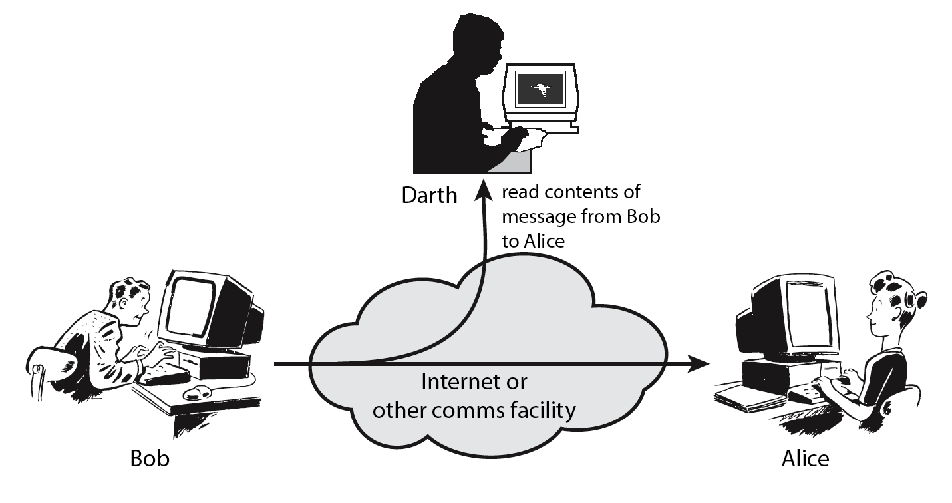
Passive Attack – Interception (Sniffing)
Packet sniffing describes the process of capturing live data as they flow across a network

Slide 16
Passive Attack – Traffic Analysis (Sniffing)
Observe traffic pattern

Slide 17
Active Attack – Interruption (Spoofing)
Packet spoofing occurs when critical information in the packet is forged by an attacker
Block delivery of message

Slide 18
Active Attack – Fabrication (Spoofing)
E.g., TCP session hijacking, DNS cache poisoning
Fabricate message

Slide 19
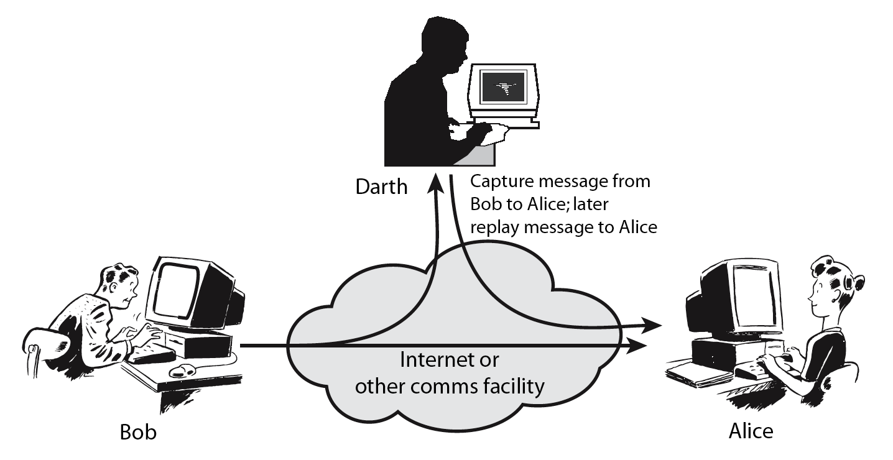
Active Attack – Replay (Sniffing + Spoofing)

Slide 20
Active Attack – Modification (Sniffing + Spoofing)
Modify message

Slide 21
Passive and Active Attacks
Passive Attack
Active Attack
Attempts to learn or make use of information from the system but does not affect system resources
Hard to detect (no alteration)
Easy to stop
Eavesdropping on, or monitoring of, transmissions
Goal of attacker is to obtain information that is being transmitted
Two types:
Release of message contents
Traffic analysis
Attempts to alter system resources or affect their operation
Hard to stop
Easy to detect (application impact)
Involve some modification of the data stream or the creation of a false stream
Four categories:
Replay
Masquerade
Modification of messages
Denial of service

Slide 22
TCP/IP Communication (Recall)

Slide 23
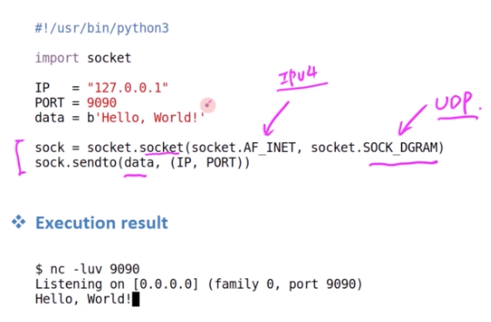
Socket Programming – Sending packets
TCP – connection-oriented transport protocol (error-free)
UDP – connectionless transport protocol (for time-sensitive communication)
Port Number – Route information to particular application process (some numbers are reserved e.g., port 80 for web servers)
UDP Client Example – sending packets using Python; and use Netcat program to test the server

Slide 24
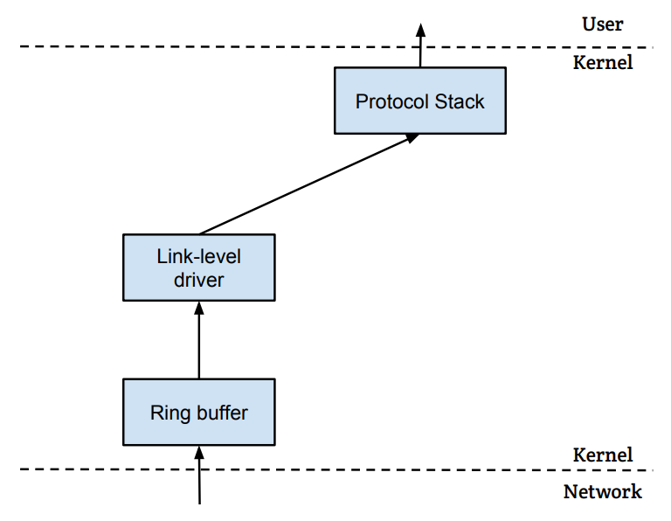
How packets are received?
NIC (Network Interface Card) is a physical or logical link between a machine and a network
Each NIC has a MAC address
Every NIC on the network will hear all the frames on the wire
NIC checks the destination address for every packet, if the address matches the card’s MAC address, it is further copied into a buffer in the kernel
Application
Upper layer processing starting with IP
Socket System Calls
OS control starts
NIC
LAN (Layer 2)

Slide 25
Sniffing and Spoofing - Related Concepts
Promiscuous Mode - NIC passes every frame received from the network to the kernel; requires root or other elevated privilege to enable
Raw Sockets – a special type of socket that allows a sniffing program to capture all packets flowing on the network cable, regardless of destination IP address or port number; used to implement spoofing
BSD Packet Filter (BPF) – Unix utility for packet filtering at the lower level; a user space program to attach a filter to a socket; Kernel can be made to discard unwanted packets as early as possible by setting filters at different places along a captured packet’s traverse path
pcap API – a packet capture API used to implement sniffing using a platform independent interface – allows portable access to operating system’s packet capture facility; libpcap in Unix (from TCPdump) and WinPcap in Windows
Wireshark tool is popular to capture packets and examine contents (without coding)
Scapy – built on top of libpcap; commonly used for productivity (for performance purposes, better to use C); Hybrid Approach also works where Scapy is used to construct packets, and use C to slightly modify packets and then send packets
Use Scapy for coding packet manipulations: packet parsing, packet sending and receiving, packet sniffing, packet spoofing, adding new protocols, etc.

Slide 26
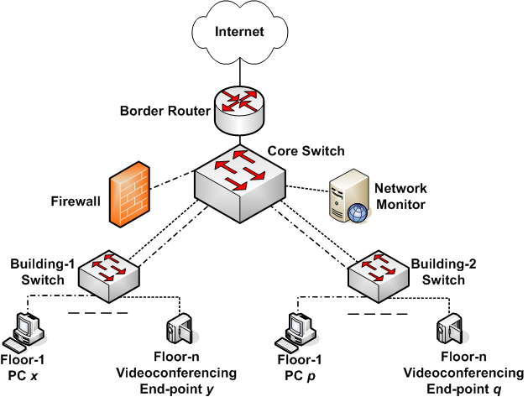
Honey Pot - Sniffing
Hacker Story -Kevin Mitnick with SDSC
Snort, Mysql

Slide 27
Attack Surfaces
Consist of the reachable and exploitable vulnerabilities in a system
Examples:
Open ports on outward facing Web and other servers, and code listening on those ports
Services available on the inside of a firewall
Code that processes incoming data, email, XML, office documents, and industry-specific custom data exchange formats
Interfaces, SQL, and Web forms
An employee with access to sensitive information vulnerable to a social engineering attack

Slide 28
Attack Surface Categories
Network Attack Surface
Vulnerabilities over an enterprise network, wide-area network, or the Internet
Network protocol vulnerabilities, such as those used for a DoS attack, disruption of communications links
Software Attack Surface
Vulnerabilities in application, utility, or operating system code
Particular focus is Web server software
Human Attack Surface
Vulnerabilities created by personnel or outsiders, such as social engineering, human error, and trusted insiders

Slide 29
Attack Surface Analysis
An attack surface analysis is a useful technique for assessing the scale and severity of threats to a system
A systematic analysis of points of vulnerability makes developers and security analysts aware of where security mechanisms are required
Use Decomposition to document components, applications and their infrastructure → develop data flow diagrams along with privilege boundaries → ensure proper controls are in place for any data crossing boundaries
Once an attack surface is defined, designers may be able to find ways to make the surface smaller, thus making the task of the adversary more difficult
Ignore “high-risk, low-reward” cases
The attack surface also provides guidance on setting priorities for testing, strengthening security measures, or modifying the service or application
Determine the layers of security you need based on the threat, don’t forget they impact performance

Slide 30


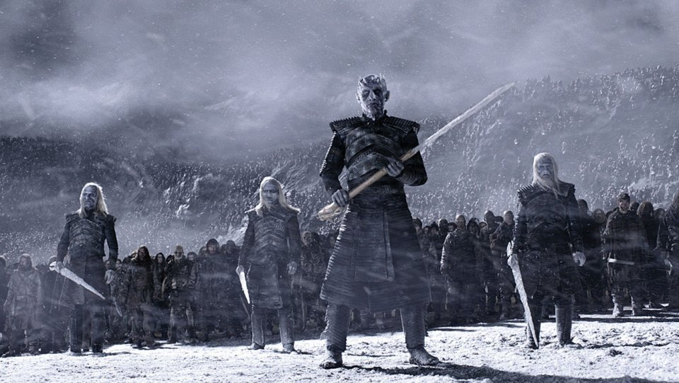
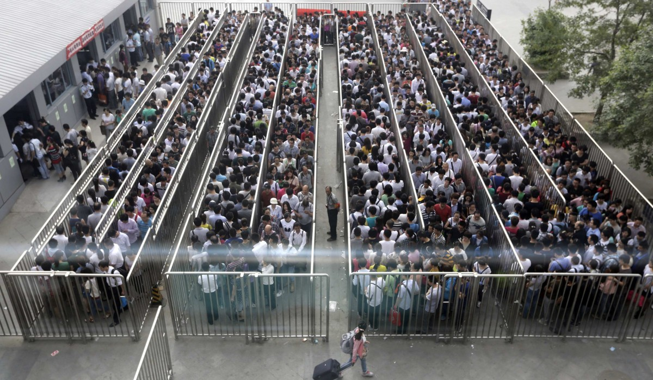
Applying all possible security tools strengths security at expense of the performance
By 2020, $101.6 billion will be spent in cyber security, to build high walls and deep moats
http://fortune.com/2016/10/12/cybersecurity-global-spending/
High Walls
Deep Moats
Invincible Army
Long Access…
There is need to bridge the gaps in the information management and security/compliance needs, while also maintaining satisfactory application performance…

Slide 31
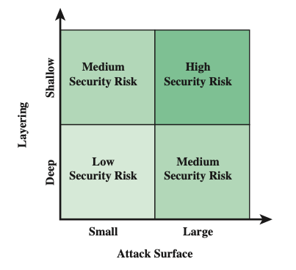
Attack Surface and Defense Depth

Slide 32
Attacks in a Cloud Computing Environment
Three actors involved; six types of attacks possible
The user can be attacked by:
Service → SSL certificate spoofing, attacks on browser caches, or phishing attacks
The cloud infrastructure → attacks that either originates at the cloud or spoofs to originate from the cloud infrastructure
The service can be attacked by:
A user → buffer overflow, SQL injection, and privilege escalation are the common types of attacks
The cloud infrastructure → the most serious line of attack; Limiting access to resources, privilege-related attacks, data distortion, injecting additional operations
The cloud infrastructure can be attacked by:
A user → targets the cloud control system
A service → requesting an excessive amount of resources and causing the exhaustion of the resources

Slide 33
Threat Modeling
Threat model - a framework which details internal and external vulnerabilities, as well as objectives and countermeasures
Five major threat modeling steps:
Defining security requirements
Creating an application diagram
Identifying threats
Mitigating threats
Validating that threats have been mitigated

Slide 34
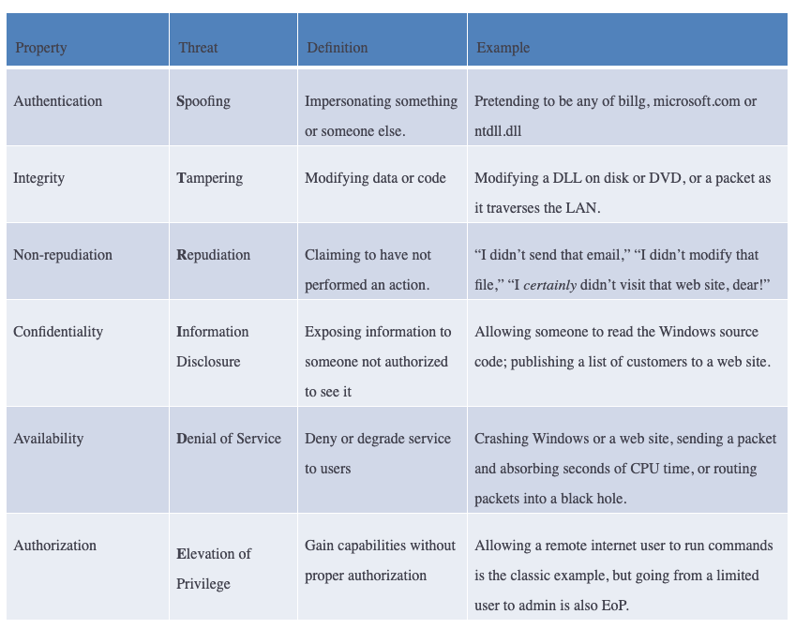
Threat Models
Microsoft STRIDE
https://www.microsoft.com/en-us/securityengineering/sdl/threatmodeling

Slide 35
Fundamental Security Design Principles
Economy of mechanism
Fail-safe defaults
Complete mediation
Open design
Separation of privilege
Least privilege
Least common mechanism
Psychological acceptability
Isolation
Encapsulation
Modularity
Layering
Least astonishment
Despite years of research and development, it has not been possible to develop security design and implementation techniques that systematically exclude security flaws and prevent all unauthorized actions
In the absence of such foolproof techniques, it is useful to have a set of widely agreed design principles that can guide the development of protection mechanisms [NSA/DHS Proposed]

Slide 36
Security Design Principles
Economy of mechanism
Design of security measures embodied in both hardware and software should be as simple and small as possible
The motivation for this principle is that - small design is easier to test and verify thoroughly; complexity complicates management
Fail-safe defaults
Access decisions should be based on permission rather than exclusion
Default situation is lack of access, and the protection scheme identifies conditions under which access is permitted
Complete mediation
Every access must be checked against the access control mechanism
Systems should not rely on access decisions retrieved from a cache
Open design
Design of a security mechanism should be open rather than secret
For example, although encryption keys must be secret, encryption algorithms should be open to public scrutiny

Slide 37
Security Design Principles (2)
Separation of privilege
A practice in which multiple privilege attributes are required to achieve access to a restricted resource
E.g., multifactor user authentication, which requires a password and a smart device, to authorize a user
Least privilege
Every process and every user of the system should operate using the least set of privileges necessary to perform the task
E.g., use of this principle can be seen in role-based access control
Least common mechanism
Design should minimize the functions shared by different users, providing mutual security
This principle helps reduce the number of unintended communication paths
Psychological acceptability
Security mechanisms should not interfere unduly with the work of users, while at the same time meeting the needs of those who authorize access
If security mechanisms hinder the usability or accessibility of resources, users may opt to turn off those mechanisms

Slide 38
Security Design Principles (3)
Isolation
Public access systems should be isolated from critical resources (data, processes, etc.) to prevent disclosure or tampering
In cases where the sensitivity or criticality of the information is high, limit the number of systems on which that data are stored
Encapsulation
A specific form of isolation based on object-oriented functionality
Protection by encapsulating a collection of procedures and data objects so that they may be called only at designated domain entry points
Modularity
Development of security functions as separate, protected modules and use of a modular architecture for mechanism design and practice
Layering
Use of multiple, overlapping protection approaches addressing the people, technology, and operational aspects of information systems
Least astonishment
A program or user interface should always respond in the way that is least likely to astonish the user
For example, the mechanism for authorization should be transparent enough to a user that the user has a good intuitive understanding of the security goals

Slide 39
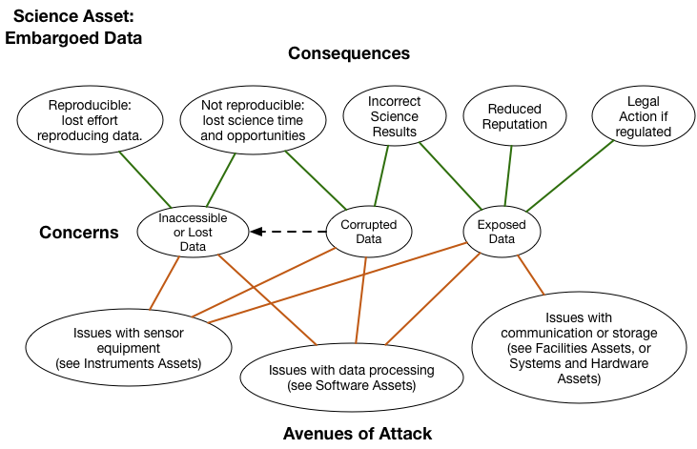
Open Science is also vulnerable to cyber attacks!
Open Science Cyber Risk Profile - http://trustedci.github.io/OSCRP/OSCRP.html

Slide 40
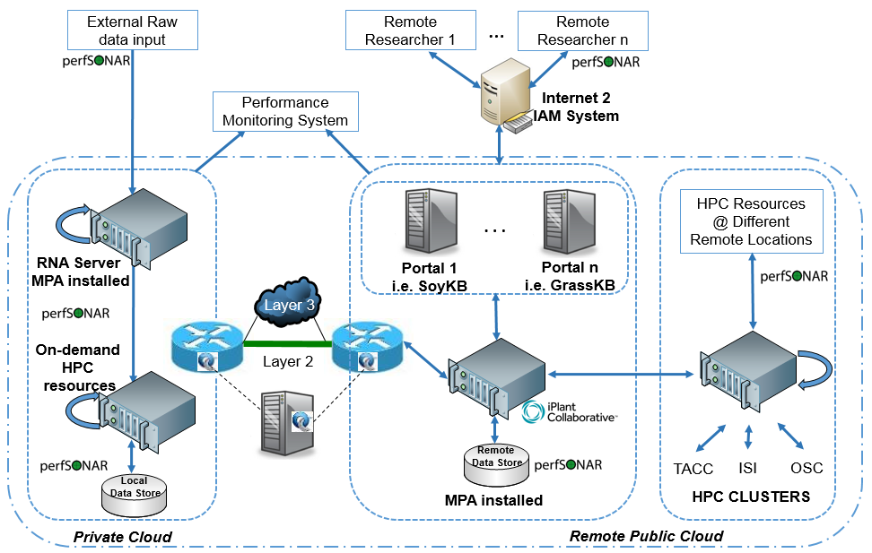
Threat Model Example – Bioinformatics Workflow
SoyKB: Distributed Computing
Notes:
At the data-level, we have noted that a more common concern for users relates to the data access levels (i.e., Loss of Confidentiality) for data-in-motion/data-at-rest/data-in-use within the various lifecycle stages. There is concern of unintended users having access to data due to overprovisioning of privileges amongst the various roles (e.g., KB administrator, domain scientist, data consumer). There is also concern on the ability of strangers to make data copies prior to formal publication of manuscripts, which then may reduce the ‘value’ of the data (considering data is treated as a currency in today’s science communities). Domain scientists are also worried about data integrity issues (i.e., Loss of Integrity) when data leaves their institu- tional boundary and infrastructure is beyond their direct control. There are known cases where data may be corrupted due to administrator error in handling databases, or if a user action causes disk space to exceed for an analysis process. There are always the chances of threats due to malicious attackers who may seek to deliberately compromise data integrity to tarnish a scientist’s reputation, or to make social statements on sensitive debate topics in our society (e.g, in context of healthcare, finance or climate change results). Lastly, there is a threat of users not being able to access their data when needed (i.e., Loss of Availability) due to e.g., administrator error involving inadvertent system management actions which cause major changes to storage that may not get notified to users in a timely manner, which may then result in partial or full loss of their data. At a meta-level, we also seek to study threat models for above issues in the context of a ‘data safety’ assessment that is personalized to the users depending on their lifecycle security requirements.

Slide 41
SEED Lab 1: Packet Sniffing and Spoofing Walkthrough
Submission Due: Jan 31st

Slide 42
Network, IoT, and Cybersecurity Lab
(EagleCyberNest @ HE 303)
Is Hiring!!!

Slide 43
Network, IoT, and Cybersecurity Research Lab
We’re the 1st student research lab focus on network and cybersecurity in the computing and software engineering department!!!
This research job counts for FGCU service-learning hours!
We have tons of network devices and resources (e.g., routers, switches, racks, high-speed network)!!!
We even have drones!
Come and join us! Email your resume now! cqu@fgcu.edu

